Slide 1



C A )
nnUnet DLMUSE
May 2023

Slide 2
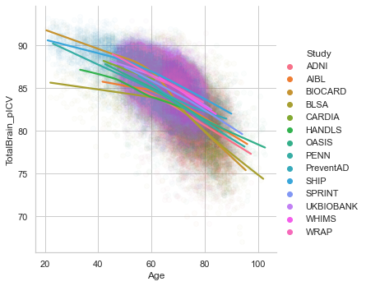
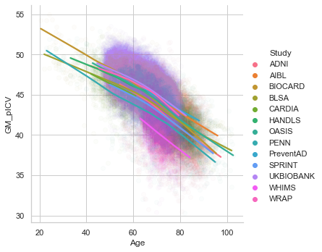
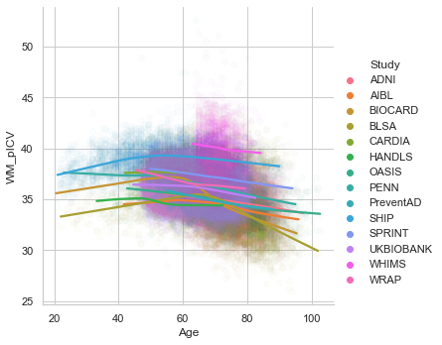
DLMUSE Age Trend

Slide 3
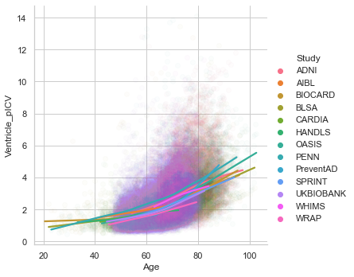
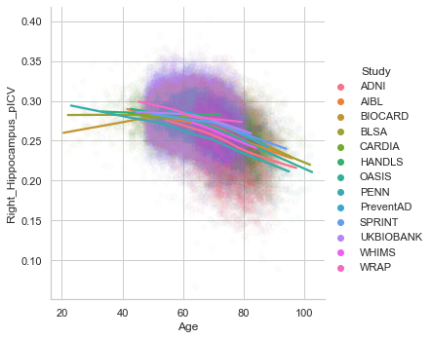
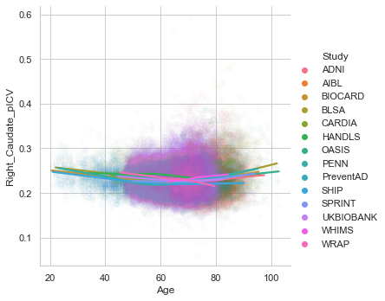
DLMUSE Age Trend

Slide 4

SPARE Model Performance
Nested 5-fold CV
Training Sample | ADNI Only |  | All iSTAGING
SPARE Type | SPARE-AD (AUC) | SPARE-BA (MAE) | SPARE-AD (AUC) | SPARE-BA (MAE)
N_train | 1,697 | 939 | 3,175 | 6,207
Original | 0.918 | 4.561 | 0.916 | 6.421
Unet MUSE | 0.927 | 4.397 | 0.925 | 6.171

Slide 5
Leave-one-site-out Validation (SPARE-AD)
Left-out Study | N (CN / AD) | Original SPARE (speci / sensi) | UNet SPARE (speci / sensi)
ADNI | 828 / 750 | 90.6% / 80.4% | 91.8% / 79.9%
AIBL | 329 / 71 | 91.2% / 87.3% | 92.4% / 88.7%
OASIS | 645 / 244 | 88.4% / 68.0% | 87.6% / 71.7%
PENN | 56 / 252 | 85.7% / 76.2% | 91.1% / 78.2%

Slide 6
Leave-one-site-out Validation (SPARE-BA)
Left-out Study | N (CN only; F / M) | Original SPARE (MAE / Pearson r) | UNet SPARE (MAE / Pearson r)
ADNI | 526 / 410 | 6.74 / 0.720 | 6.72 / 0.741
AIBL | 414 / 307 | 5.88 / 0.660 | 5.88 / 0.675
BLSA | 580 / 504 | 7.26 / 0.873 | 6.34 / 0.885
CARDIA | 471 / 421 | 6.92 / 0.372 | 6.59 / 0.378
HANDLS | 127 / 106 | 8.40 / 0.619 | 7.13 / 0.700
OASIS | 475 / 338 | 6.15 / 0.810 | 6.26 / 0.807
PENN | 123 / 61 | 7.68 / 0.835 | 6.29 / 0.859
UKBIOBANK | 584 / 500 | 6.91 / 0.682 | 6.22 / 0.726
WRAP | 185 / 75 | 6.75 / 0.633 | 5.74 / 0.762

Slide 7
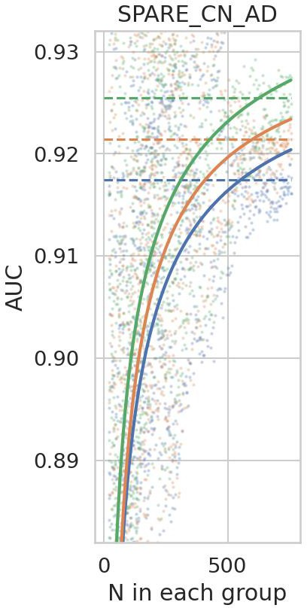
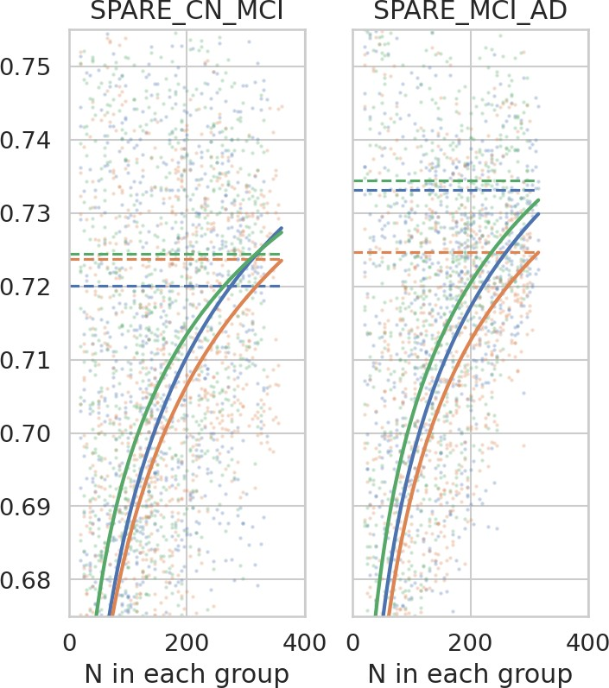
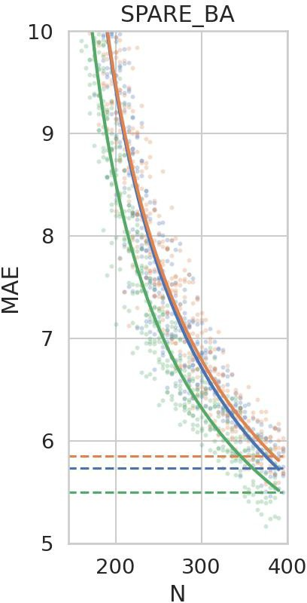
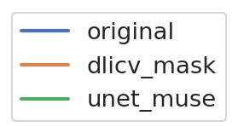
SPARE Model Performance (varying sample size)

Slide 8



